Slide 1
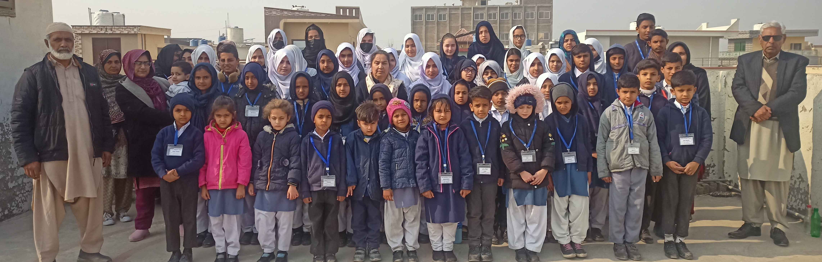
Help Humanity UK Grant Application
Photo: Razia Hasan
2025

Slide 2
Since 2010, Help Humanity UK has worked on various projects to better the outcomes of underprivileged families
Vision: To better the future of underprivileged families by focusing on health, empowerment, and education.
Key guiding principles that ensure the charity’s success
Donation of medical equipment to local hospitals and
work equipment
to local woman small business owners
Idea to have one substantial project to focus our efforts and make a bigger contribution to society
Ujala School opened in October 2017
Zero Admin cost
9 Families rehoused in flood impacted areas
Fundraising efforts to complete school building
100% compliant with Charity Commission UK
2010
2012
2014/2015
Feb 2023
Tax back through UK Gift Aid Scheme
2011
2013
2016/2017
Today
8 governing Trustees
Birth of Idea due to severe flood impacting Pakistan. Food and Medical parcels sent, and air dropped by the Army
Measles Vaccination Program supported in Badin, Pakistan
(900 children inoculated)
Sponsoring of teachers in TCS run schools in Karachi
Plot purchased to upscale Ujala School: Project to have a purpose-built & green school building
Hands on Oversight
Quarterly Newsletters to Donors
Over 500 individual donors since the beginning

Slide 3
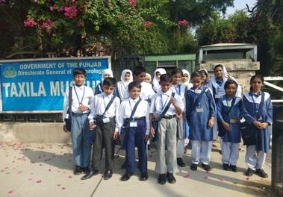
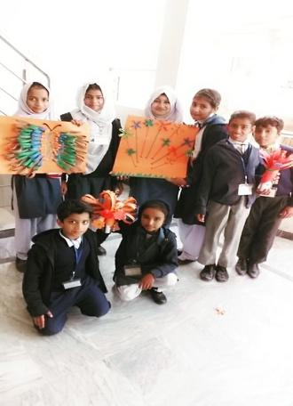
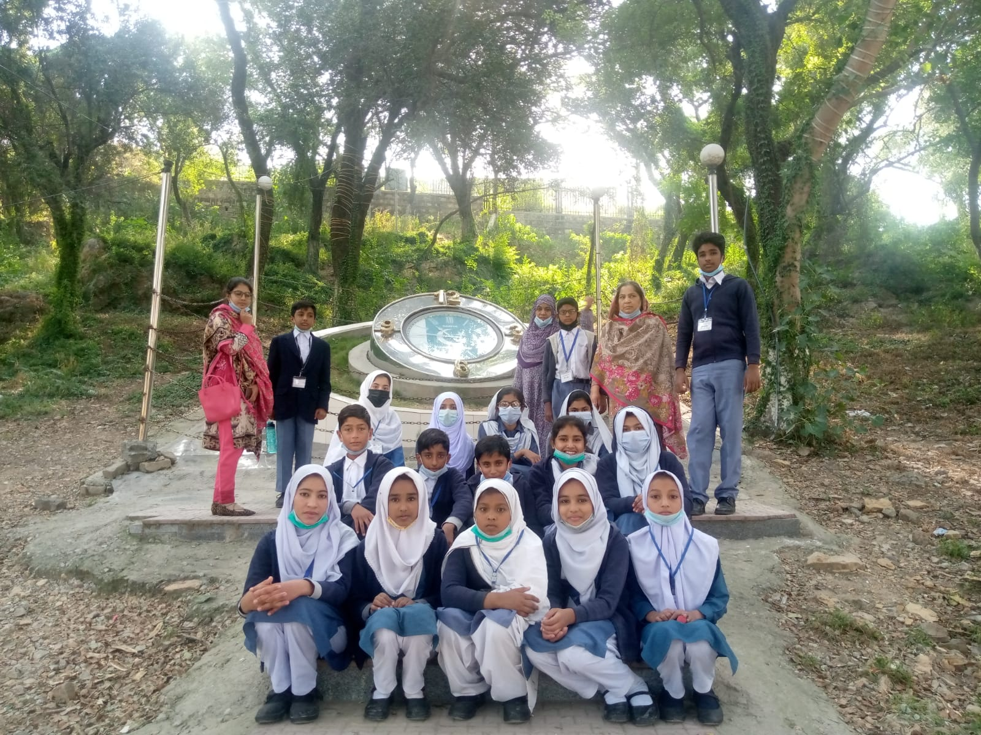
Ujala School celebrated its 5th anniversary in October 2022- with 60 pupils and 10 full-time staff
Ujala Primary School was built on the following principles:
To provide free education for the underprivileged:
No charge for books, uniforms or tuition fees. There is no cost to the parents at all. One meal is provided to the pupils daily (after all, brains do not function on empty stomach).
2. To provide a high standard of education: Teacher's training led by Razia Hasan, who has 37 years of teaching experience in the UK, in the capacity as a head teacher and five years as a school inspector.
3. Safe and secure environment: Staff are thoroughly vetted to ensure their suitability to work with children. CCTV cameras are installed in all areas of the building which are remotely monitored by trustees worldwide.
4. Believe in the ‘whole child’: Focus not only on academic achievements. Aim to develop each child’s talents, skills and interests as well as their emotional well being, which is key in every learning environment and especially so for children from underprivileged backgrounds.
Major Milestones
Registered with Government of Punjab as a Middle School (Grade 8 being the highest class)
Coverage through local media on work being done to raise awareness in local community and gain support
Enrolment of 60+ pupils – each with family checks to ensure eligibility and priority for most deserving families
Weekly virtual teachers training established
Computer lab fitted and operational
Continuity of schooling for the children through underprivileged during lockdown – through tele coaching and homework for pupils, and supporting families with essential supplies to ensure pupils stay away from child labour
Further education of pupils (Class 9 & 10) graduating from our school by paying school fee and supplies for students to continue education in Farooqi School, Wah Cantt
Please visit https://www.ujalaschool.org/ for more details.

Slide 4

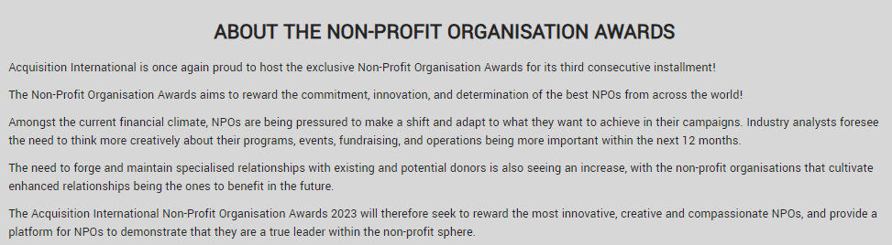
In 2023 Help Humanity UK was awarded the Best Pakistan-Focused Education & Welfare Organisation in the UK

Slide 5

In 2023 Help Humanity UK has been awarded the Best Pakistan-Focused Education & Welfare Organisation in UK

Slide 6
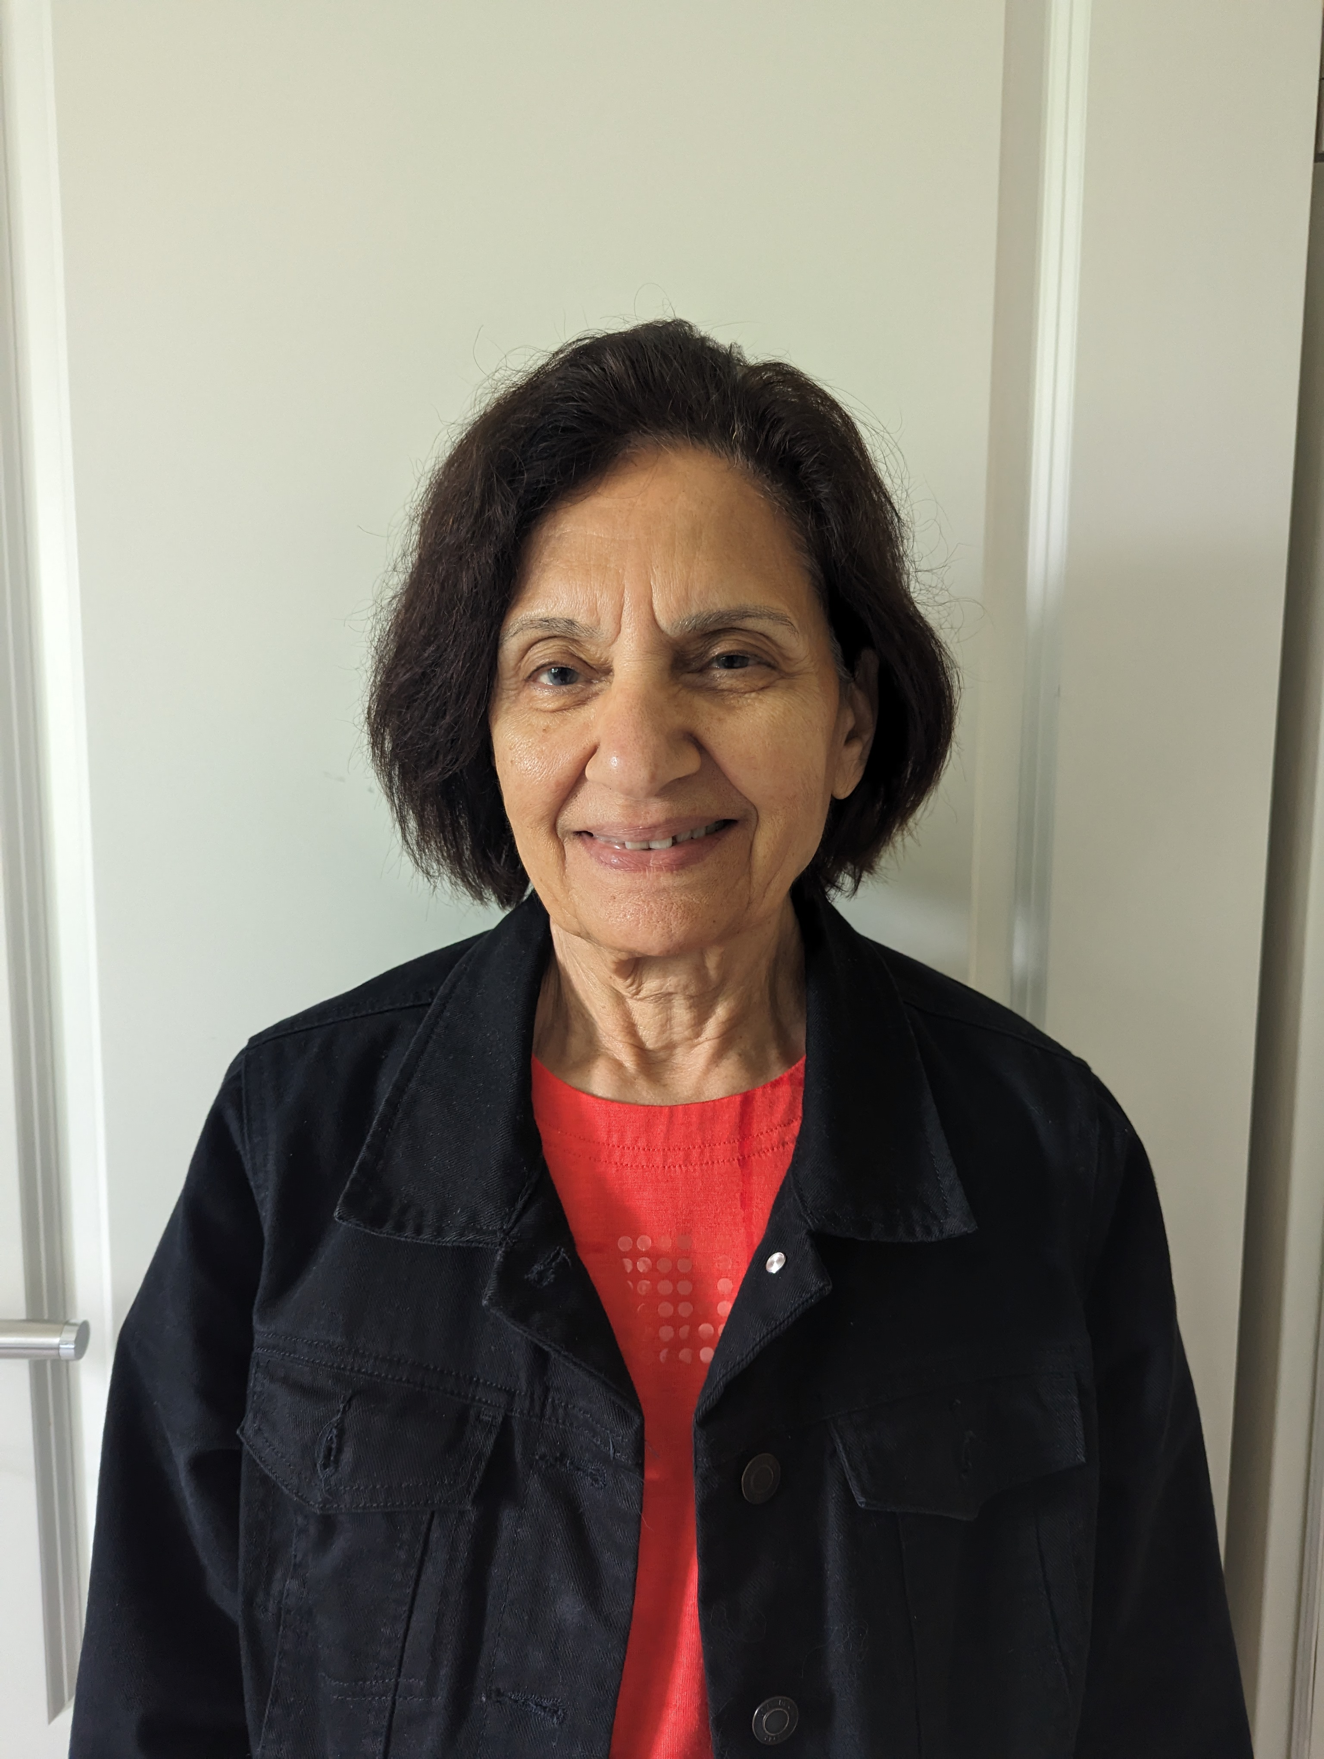
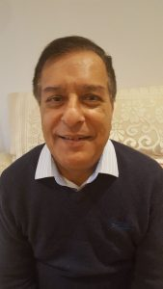
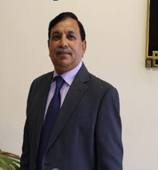
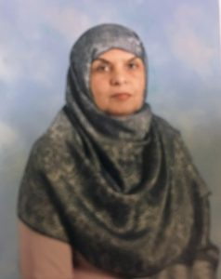
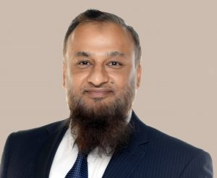
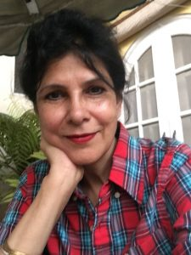
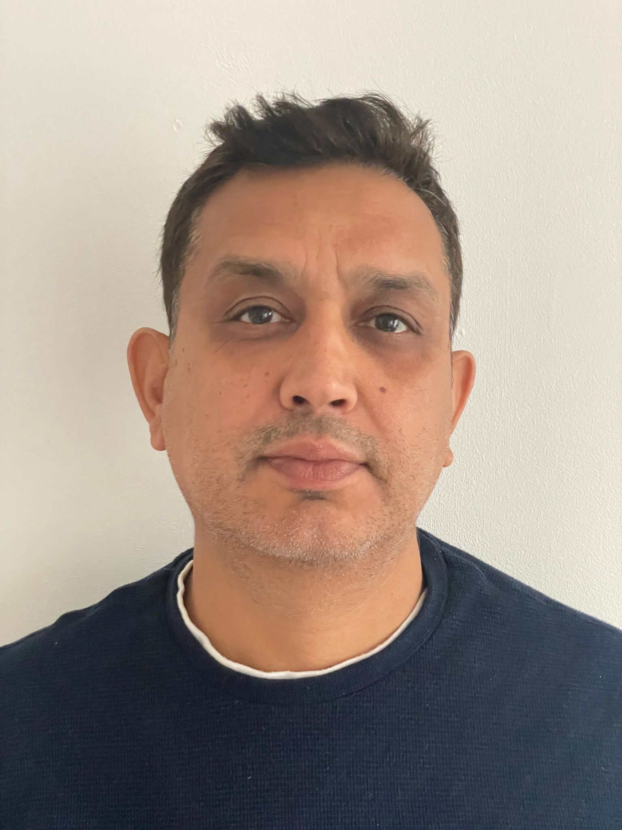
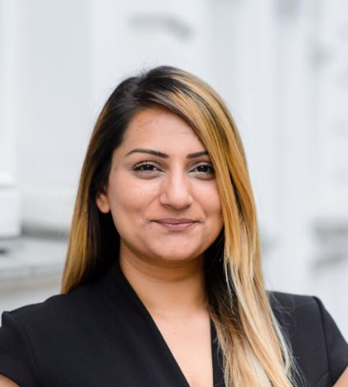
Our Team of trustees bring experience from various backgrounds to ensure project success
Razia Hasan
Fiaz Choudhary
Muhammad Azhar
Atiya Saithna
Founding member and the Chairperson of Help Humanity UK
37 years of teaching experience in the UK, in the capacity as a head teacher and five years as a school inspector
30 years of policing experience in the United Kingdom working in rural Oxfordshire as well as Metropolitan London.
Trustee foreseeing the financial accounts of the charity.
32 years of experience in the petroleum industry in Pakistan setting up health and safety management systems, staff training and development etc
30 years teaching career; last 7 years as a Head teacher both of a State and Independent Islamic schools in London UK
Dr. Rehan Ahmed
Dr. Farhana Akbar
Arfan Ahmad
Bushra Zafar
Over 25 years of experience in higher education linking teaching, research and project management skills in Europe and Middle East
Dr Farhana Akbar has a MEd from Sheffield University in the UK and a PhD in Special Education from US. She has over 3 decades teaching experience and school management.
Responsible for onsite interactions with local government for school registration and overseeing building construction.
Responsible for the technological management and representation of the school over different channels. She brings with her over ten years of experience in Business Development and Management in UAE and Germany.

Slide 7
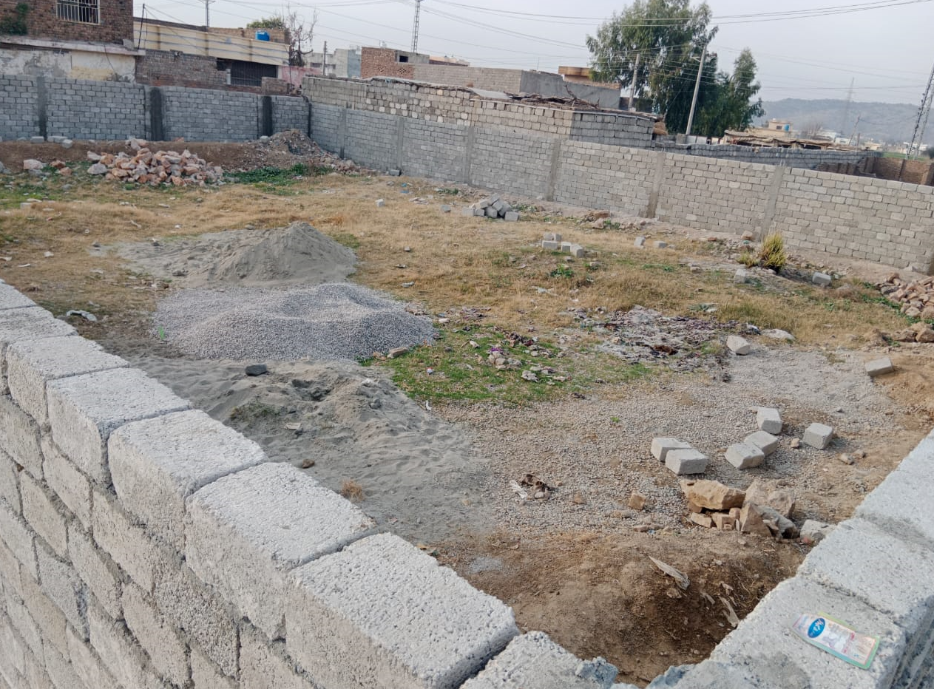
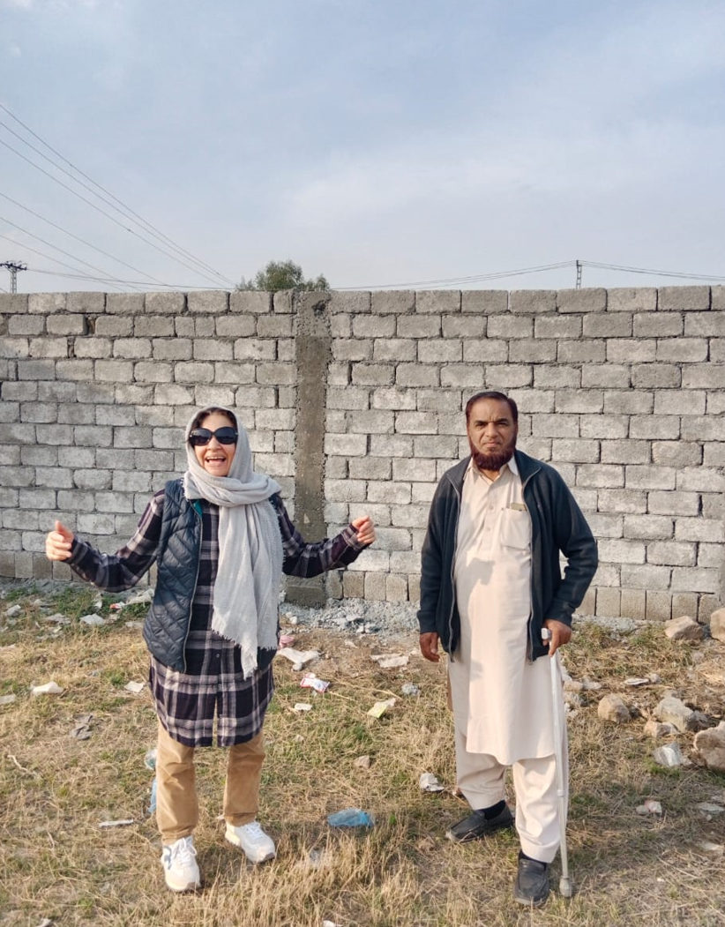
Project in focus: Upscaling successful PoC to a purpose build school ‘Green’ building
From
School operational since 2017 with a total of 60 pupils spread over kindergarten to Grade 8.
Donated residential building converted to be used as a school (2040 sq./feet), no playground, staff rooms etc…
Roof of the residential building serving as a playground in recess/ lunch breaks.
To
Upscaling existing setup to provide education from Kindergarten/preschool (including nursery) to Grade 10 (board exams). Total students to go from 60 to 150 pupils.
Have a Green purpose-built school – avoid disruption in studies due to shortage of electricity or other services (eg installation of Solar panels, Rainwater recycling, Nature area).
Have a max of 15 pupils per class to keep the focus on the child as a ‘whole’ – including offering extra curricular activities.
Space Requirement
10 Classrooms (Grade 1-10)
Pre-school/ Kindergarten room
Library/ Art Lab
Computer Lab
Science Lab
Staff room/ Supplies room
Kitchen/ serving area for lunch
Assembly/playground area
Plot picture
Cost Type | Amount (GBP) | Status
Land cost including transfer charges | 35k | Paid
Building cost estimation including (including registration, security system, IT infrastructure) | 150 – 200k | Fund Raising
Total | 185k – 235k
Please see Appendix for CAD building design
Grant application

Slide 8
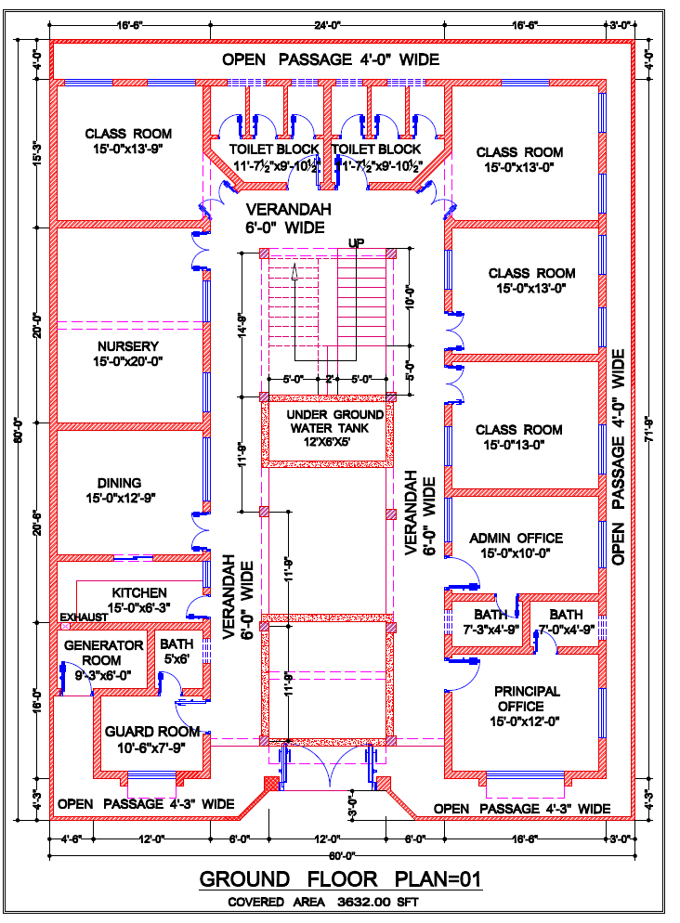
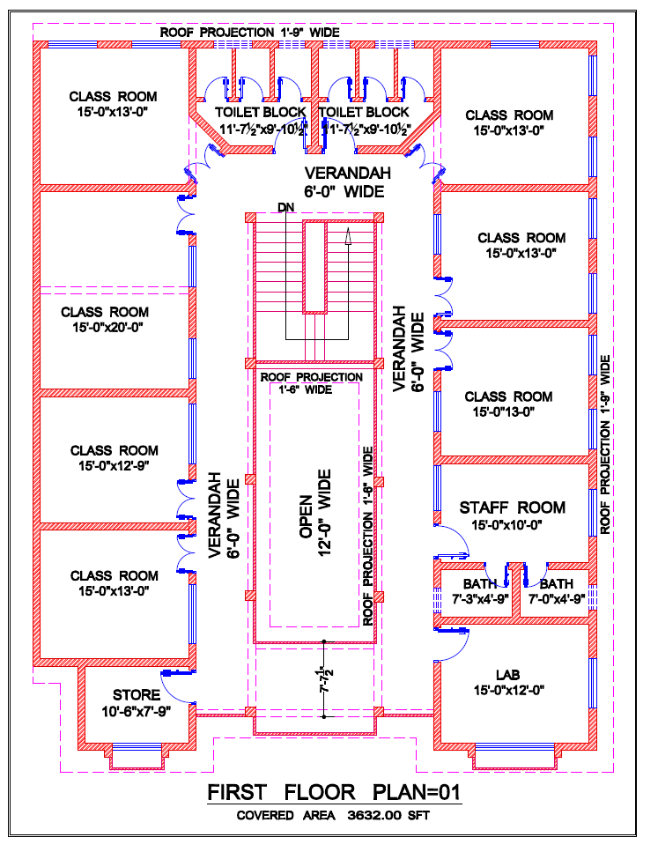
Appendix: Building Design

Slide 9
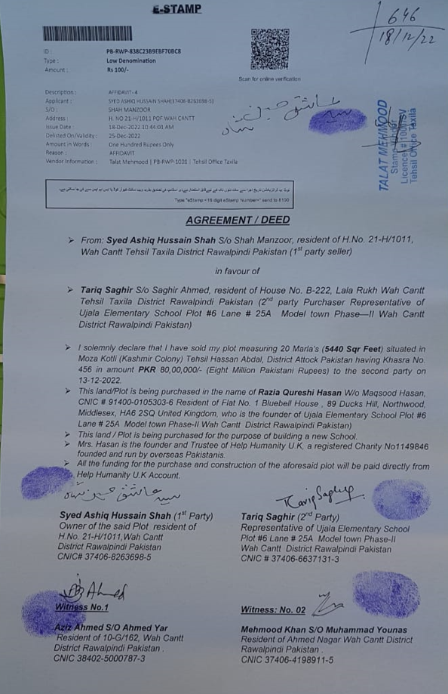
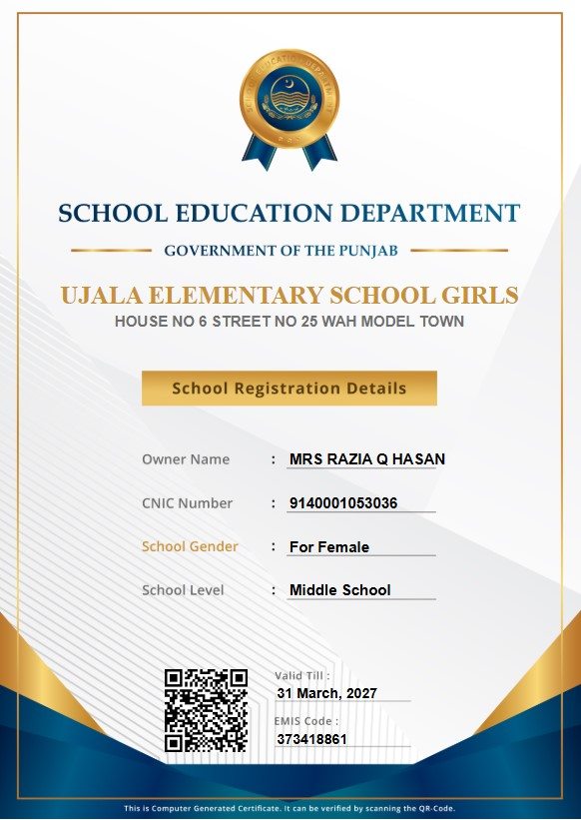
Appendix: Land purchase confirmation and school registration

Slide 10
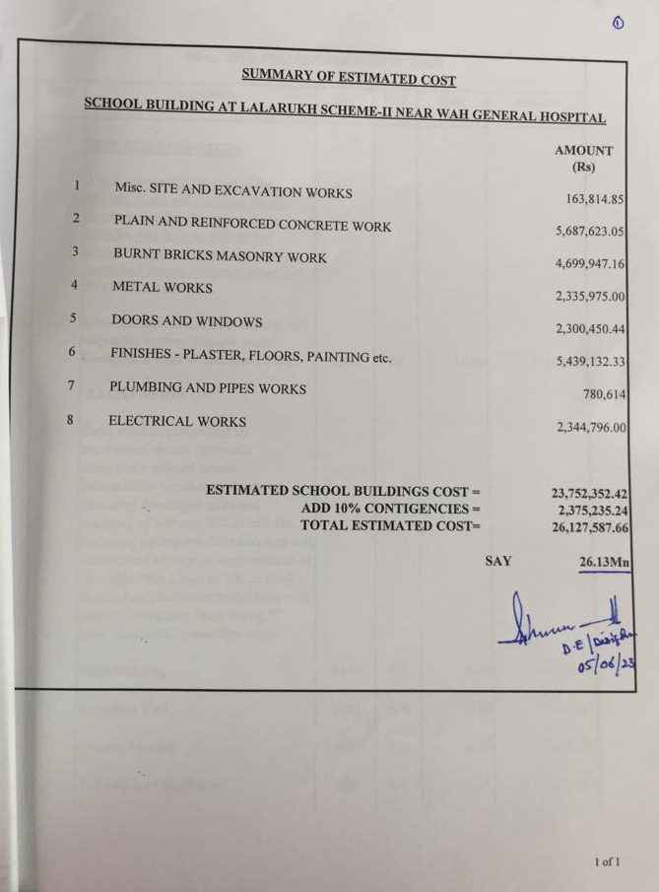
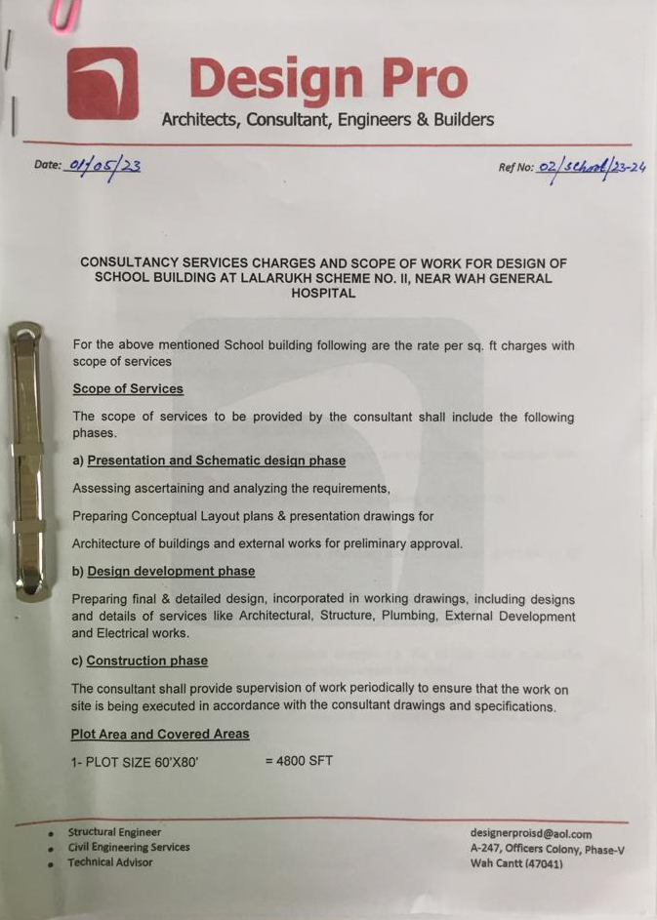
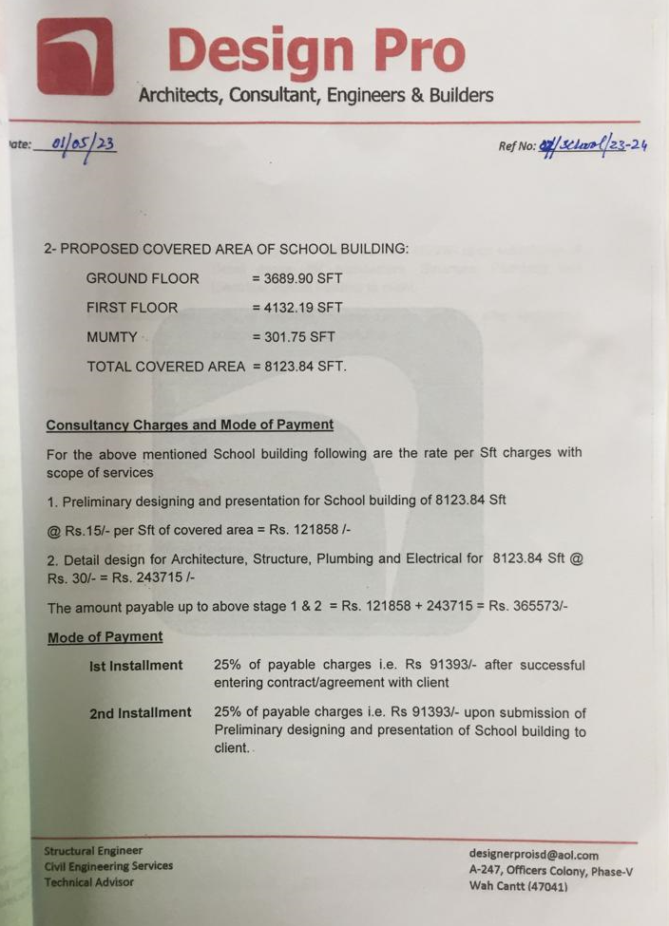
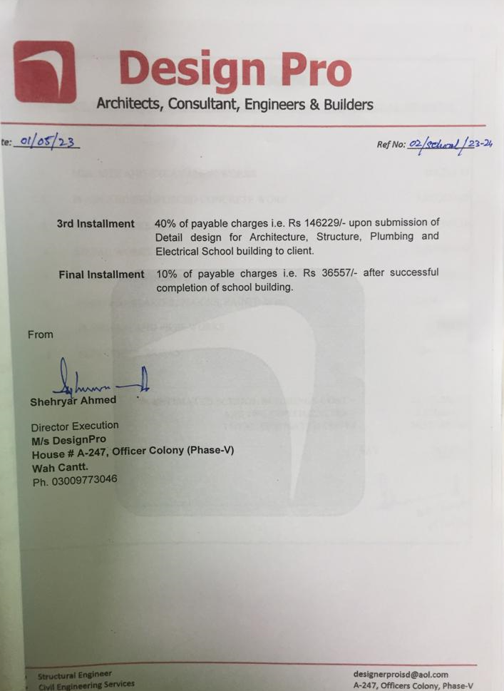
Appendix: Cost Estimate

Slide 11

Support us via recurring payments or a one-off payment towards school building
Bank transfer:
UK Account details
Account name: Help Humanity UK
Bank Address: Lloyds Bank – Northwood Branch, HA6 1AB, UK
Account No: 13201660 IBAN: GB47 LOYD 3015 9513 2016 60
Sort code: 30-15-95
Pakistan Account details
Account name: Ujala Elementary School Girls
Bank Address: Meezan Bank Limited, Wah Cantt Branch, Ground Floor, Mall View Plaza, Mall Road, Wah Cantt.
IBAN: PK65 MEZN 0053 0201 0880 3240
BIC code: MEZNPKKAXXX
helphumanityuk@yahoo.com
Click Here to Donate

